Slide 1

9th Collaboration Meeting of the BM@N Experiment at the NICA Facility
Development of an interactive Virtual Reality application for the BM@N experiment visualization
Anastasiia Iusupova, Saint Petersburg State University 15.09.2022

Slide 2
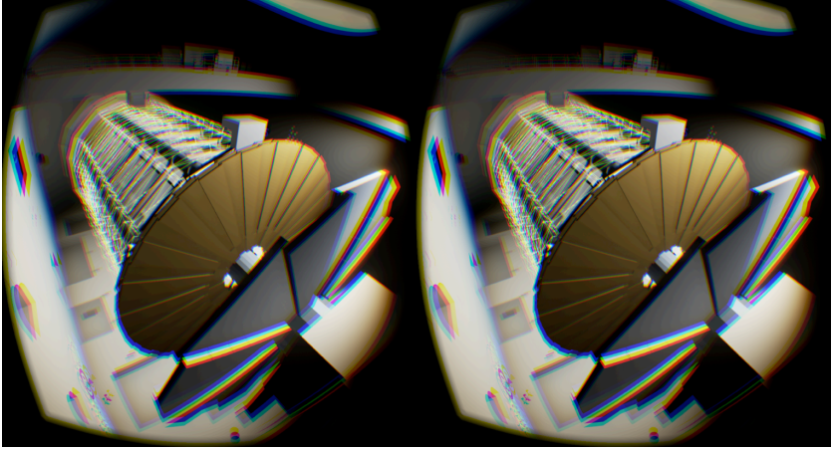
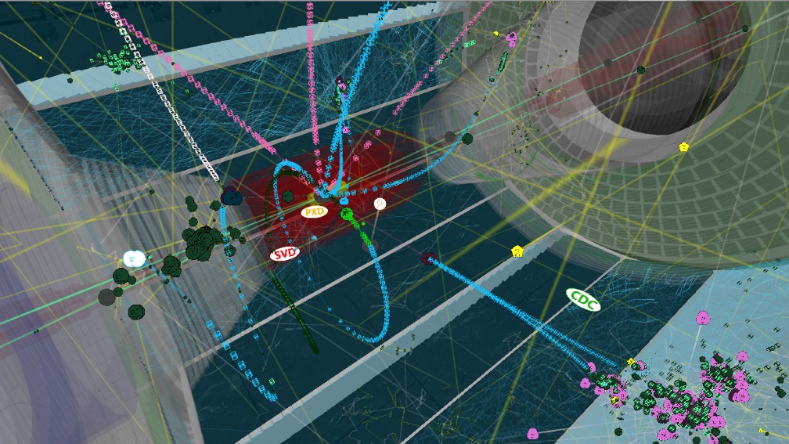
Motivation and problem statement
Virtual Reality (VR) simulates the user’s physical presence in a virtual environment
The application runs on a head-mounted display that provides visual and aural experience of the simulated environment.
Different degrees of realism and immersion are possible.
Fig. 1 – ATLASrift application: stereo view of the detector and cavern
Let the general public virtually visit HEP detectors and explore experimental sites.
Let people look at simulated collisions in a simplified yet realistic environment.
Can be used as an educational tool and in public events, in museums and science centers, and in meetings.
Fig. 2 – Belle II VR application: electron positron collisions visualization

Slide 3
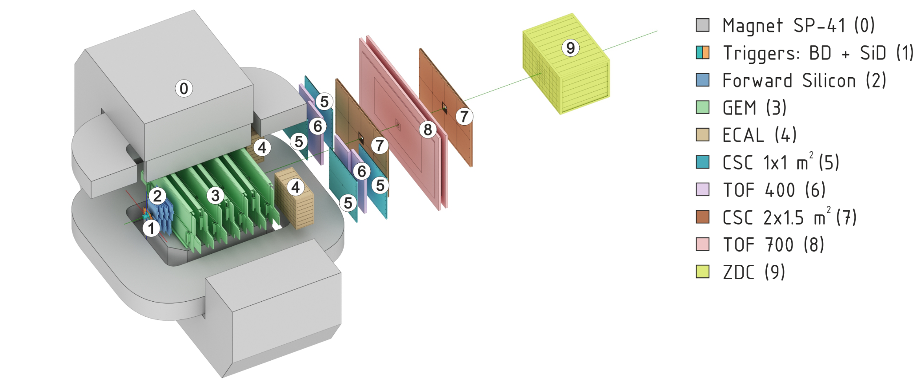
Motivation and problem statement
Data conversion problem: how to export the geometric and collision data?
ROOT geometry can be saved in a root file, as C++ macro or as GDML file.
GDML stands for Geometry Description Markup Language.
It is an application-independent geometry description format based on XML.
It is mainly used for geometry interchange between ROOT and Geant4 framework.
Fig. 3 – BM@N run 8 geometry scheme

Slide 4
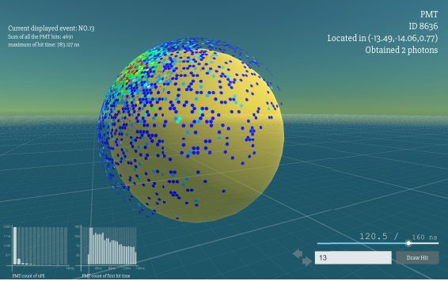

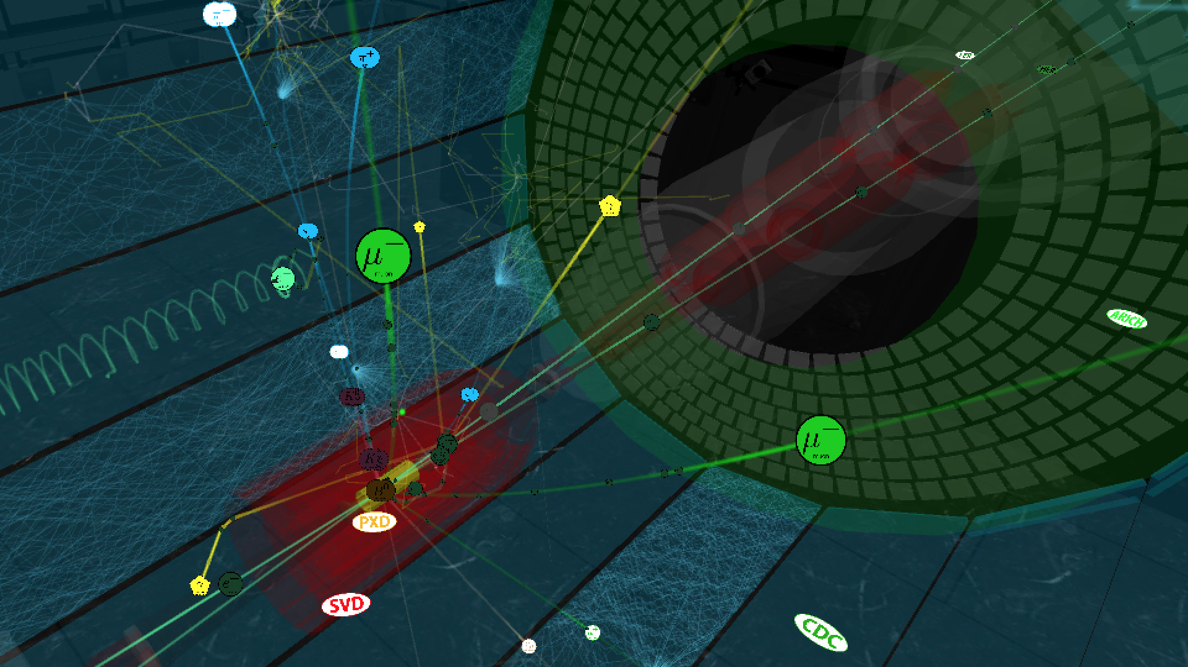
Unity game engine
Cross-platform
3D models display
Particle system feature
GUI
Communication with player via events
Virtual Reality and Augmented Reality support
Fig. 4 - ELAINA event display for JUNO experiment based on Unity
Fig. 5 – Belle II VR app based on Unity

Slide 5
GDML format description
Define
Positions
Rotations
Materials
Element
Material
Solids
Geometric objects (boxes, tubes, trapezoids, etc.)
Boolean operations (union, subtraction)
Structure
Volume
Assembly
Setup
World reference

Slide 6
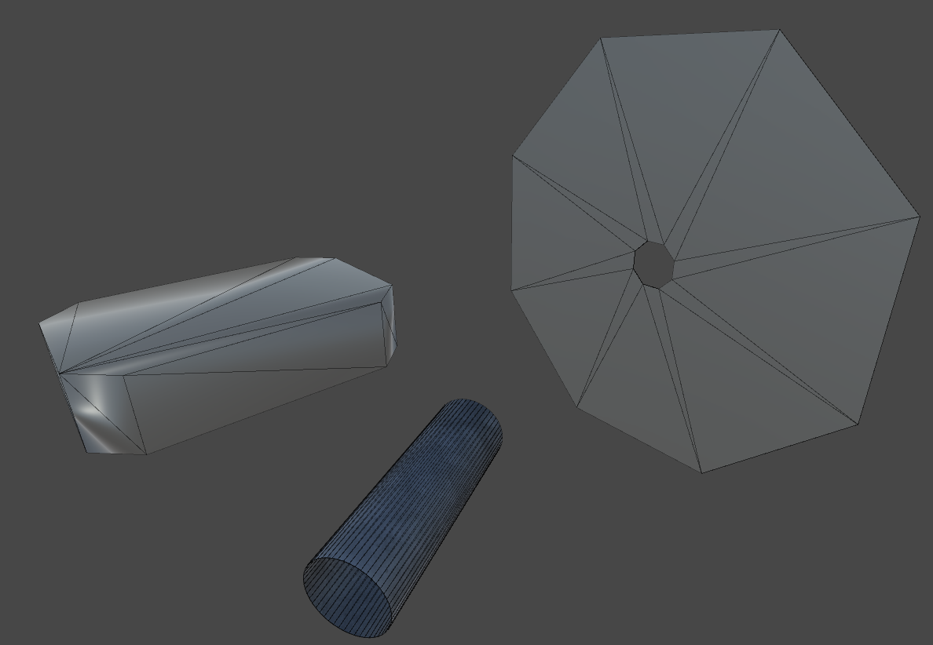
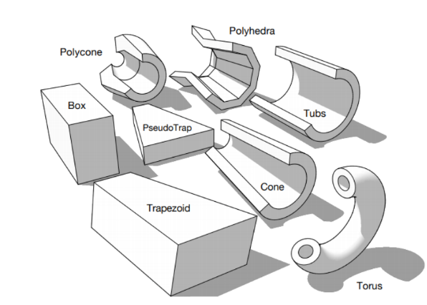
Solids: geometric volumes generation
Manual mesh generation steps:
Calculate number of vertices
Fill vertices based on geometric shape parameters
Fill texture coordinates
Build triangles
Fig. 7 - Example of generated meshes for the extruded solid, tube, and octagon
Fig. 6 - Example of geometric shapes used for the detector geometry visualization

Slide 7
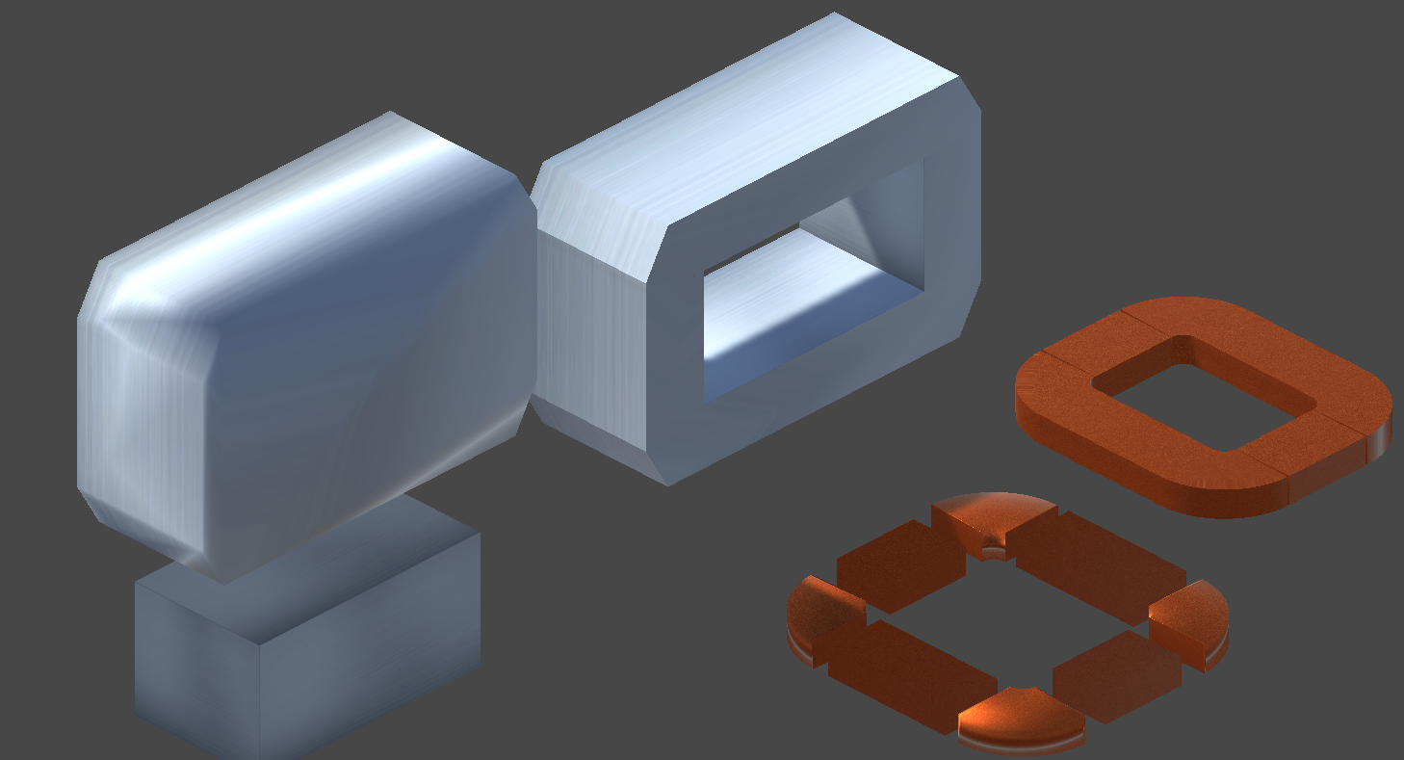
Solids: Boolean operations
Boolean operation steps:
Find two objects involved into Boolean operation
Set objects’ pose if needed
Place 2nd object to 1st object’s coordinate system
Perform union or subtraction operation on objects using Constructive Solid Geometry methods for new mesh
Triangulate mesh
Check if triangles’ normal is not inverted
Return generated mesh
Fig. 7 - Example of Boolean operations results: subtraction and union

Slide 8
Rendering queue
Geometric volumes
Boolean operations
Set materials
Set correspondence between geometric shape and it’s pose
Hierarchy building: set positions and rotations in local coordinate system
Set world reference
Clear temporary geometric volumes

Slide 9
GUI elements
Player
Character controller
Mouse handler
Player controller
Event system
Handles input, raycasting, and sending events
Main menu
Game start and exit
Light, camera, environment

Slide 10
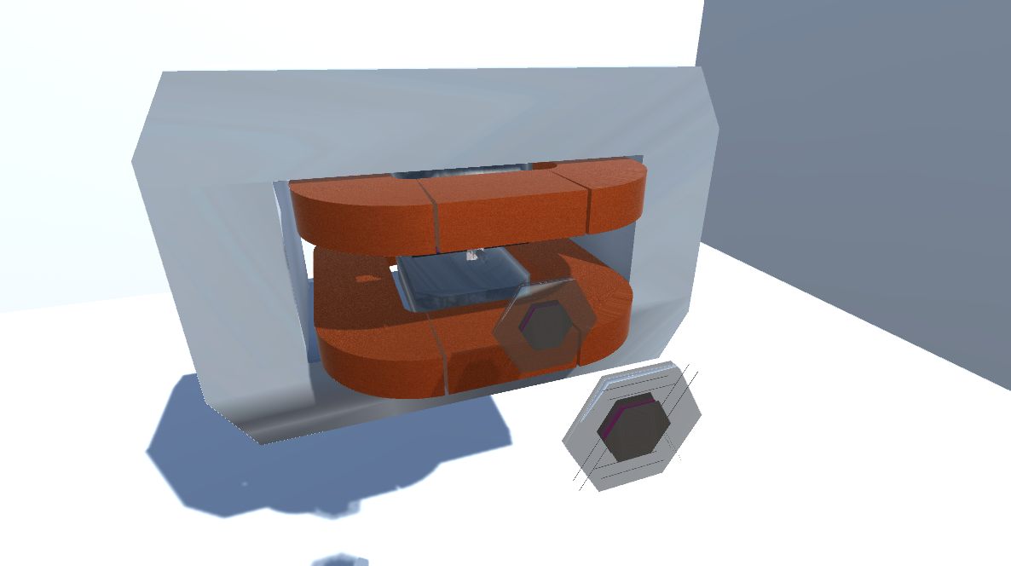
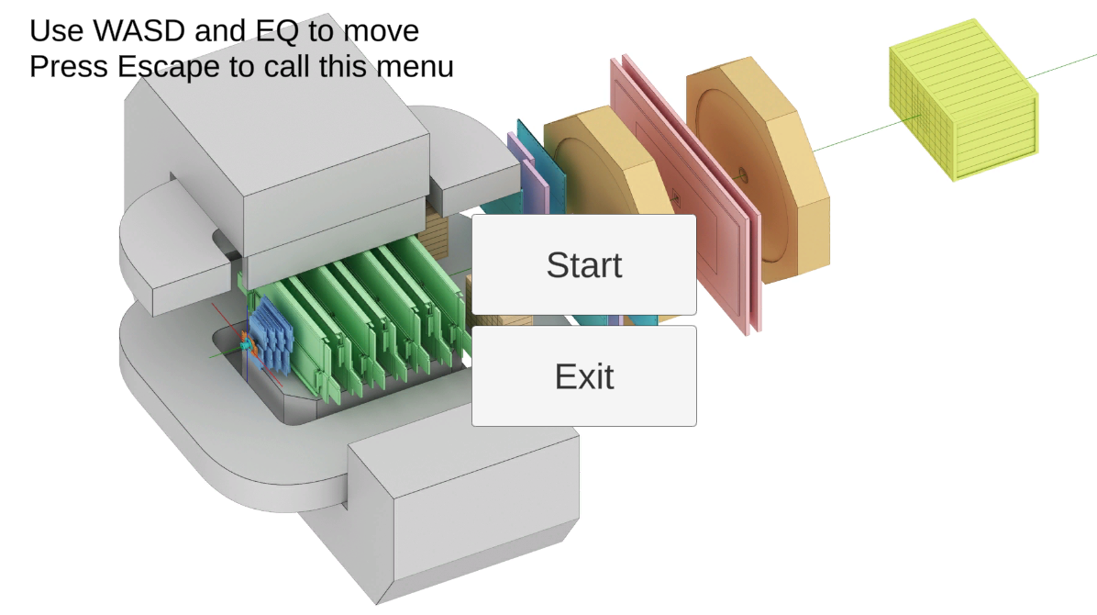
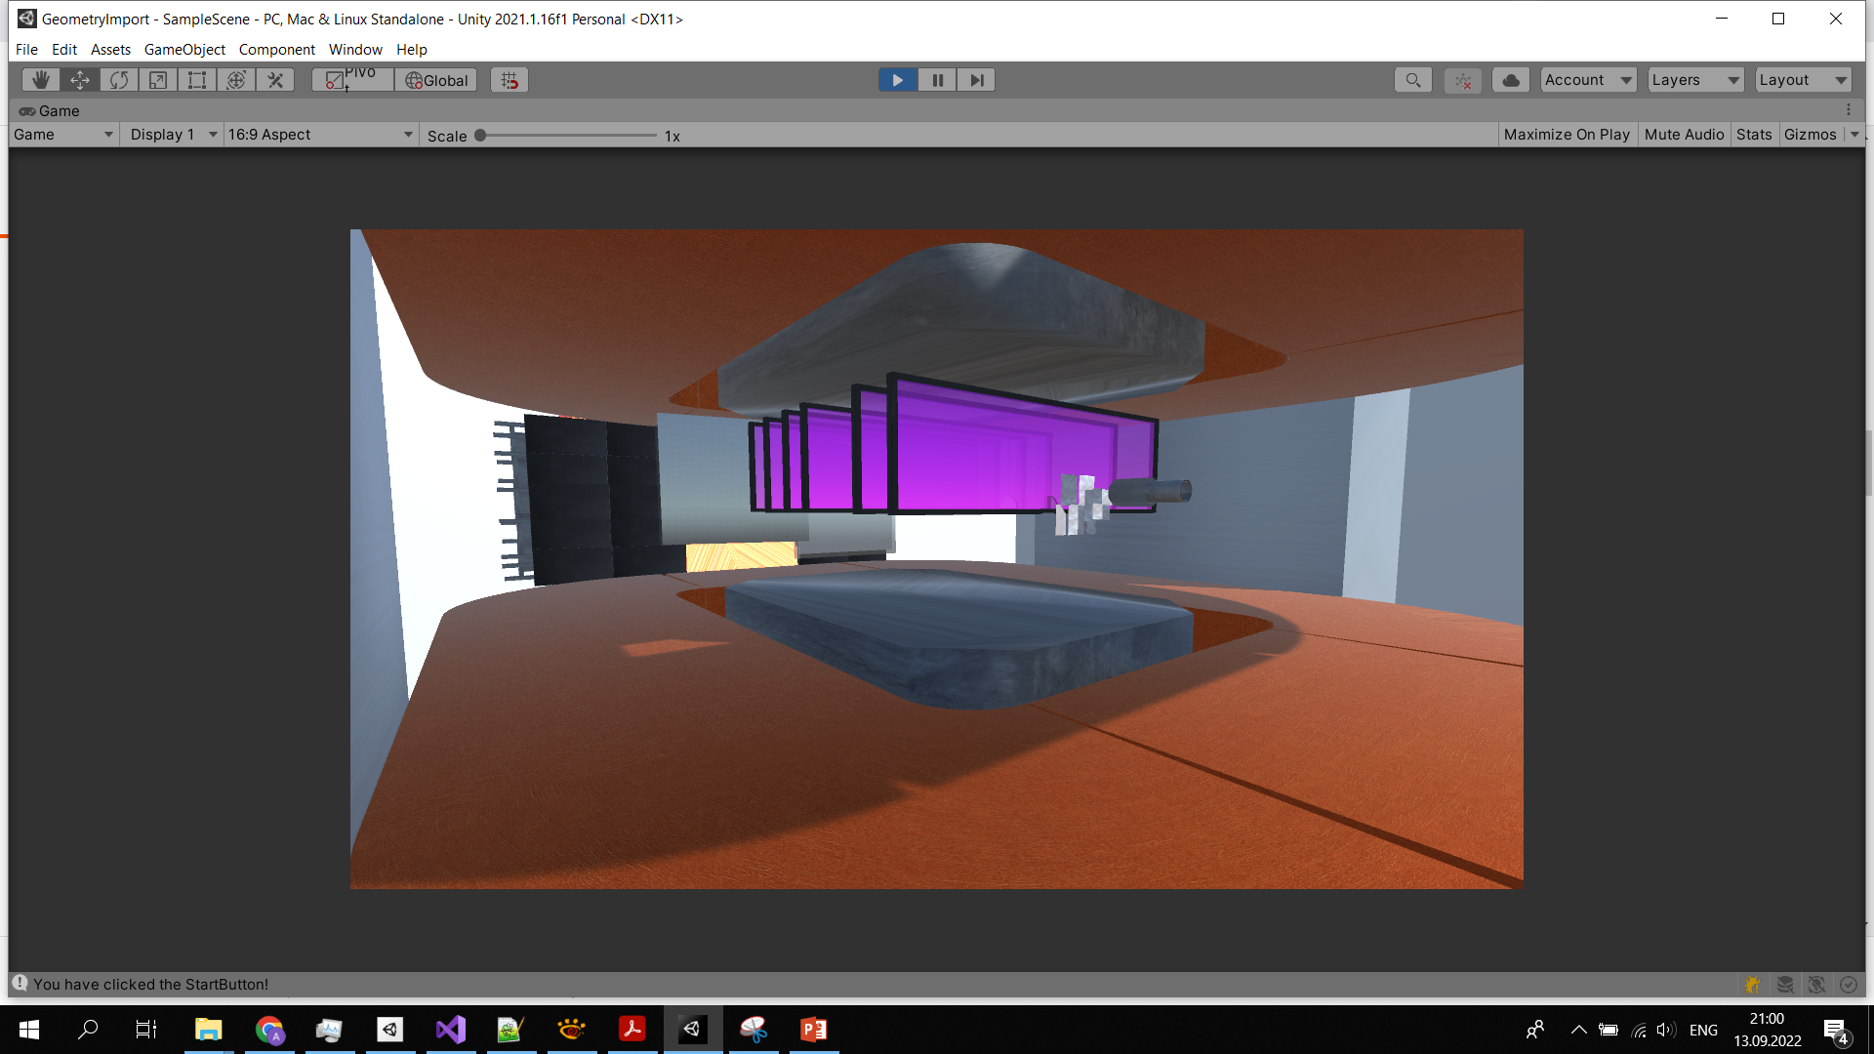
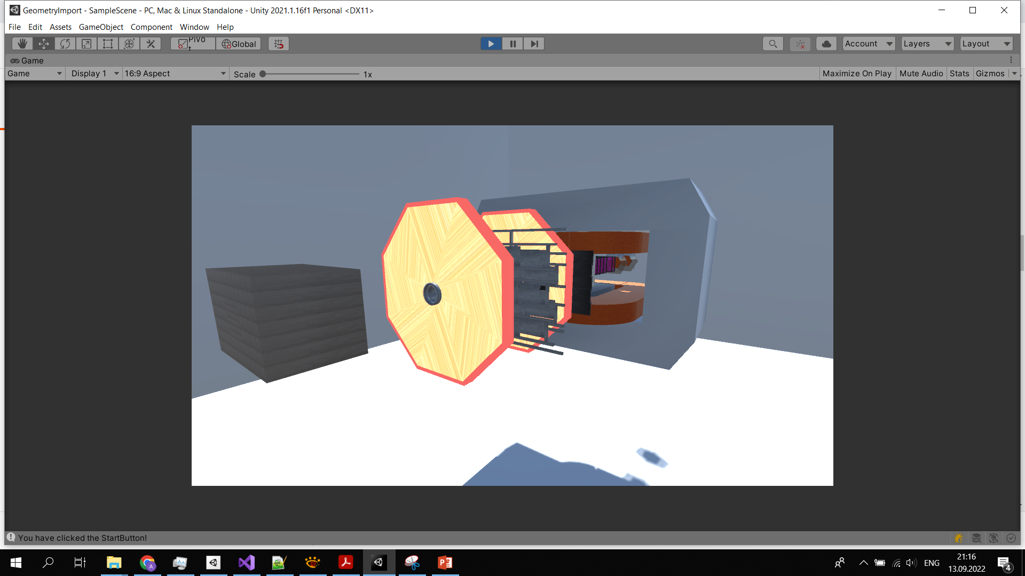
Current result
Performance: 15 FPS (66 ms)
Fig. 8 – Main menu
Fig. 9 – Screenshots with generated geometry (run 7)

Slide 11
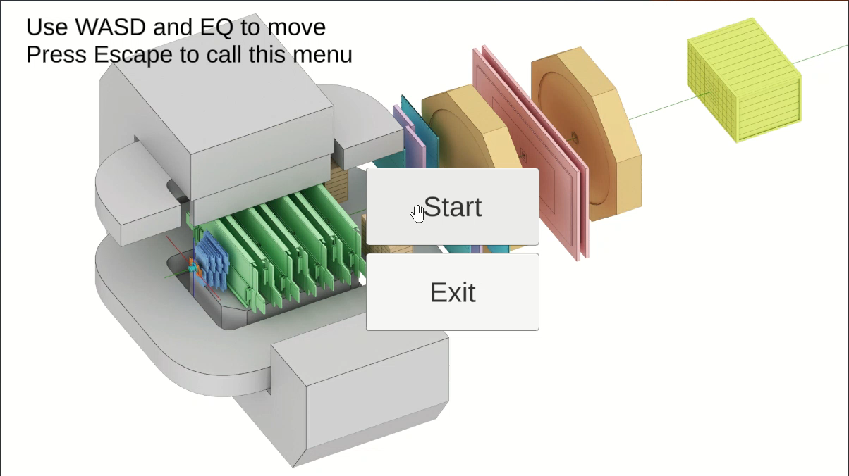
Current result

Slide 12

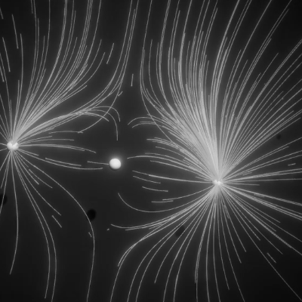
Future work
Export tracks and collisions
GUI elements: object selection and manipulation, selected object’s information display
Detailed environment
Fig. 10 – Unity particle system usage example

